Slide 1

FUNDRAISING REACTIVATION CAMPAIGN Predictive Analysis Project - Team 3

Slide 2

Content
Introduction
Project Definition
Datasets
Project Scope
Model Building
Data Preparation
Model Selection
Final Model
Business Interpretation
Lift, Cumulative Gains
Profiling, Recommendation

Slide 3



Introduction
Fundraising organization (DSC)
Lapsed donors (2 years; ≤ 5 EUR)
Re-activation campaign (Jul 2014)
Predicting project
[1] Donors respond
[2] Gift ≥ 30 EUR
[3] Ranking donors

Slide 4
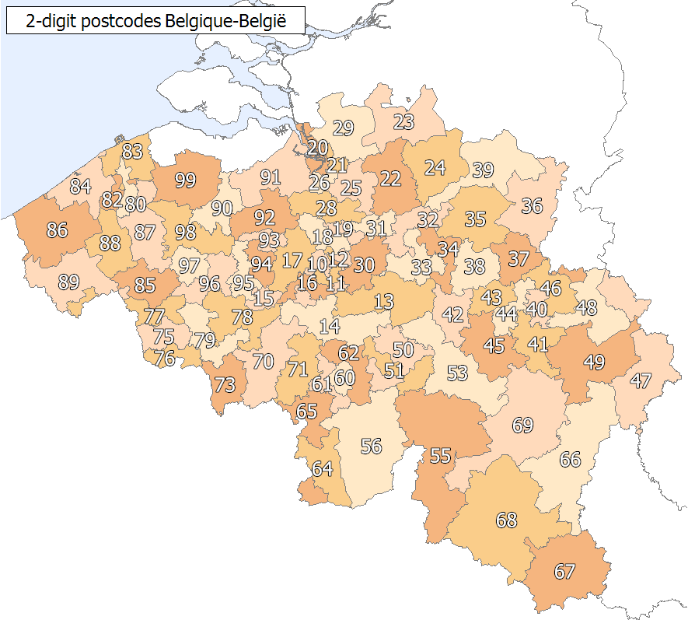
Datasets
Campaigns – 7 reactivation campaigns, delivering date
Donors – 44,691 donors and geographic information
Selections – 44,602 donors who were selected for 7 previous re-activation campaigns
Gifts – 44,686 donors who made donation in 373 previous re-activation campaigns, from 05/01/1995 to 03/07/2014
Score – 31,960 selected donors for future re-activation campaign (ID: 7541)
Notes:
BeGeo – geographic data of Belgium by zipcode

Slide 5
Project Scope
4 years
2 weeks
2 months
Population – 44,602 inactive donors of last 7 re-activation campaigns (selections dataset)
Granularity – individual level
Timeline
Past: 4-years
Gap: 2-weeks
Future: 2-months
Cam. No. | Period begin | Gap begin | Send begin | Send end
5233 | 2008-09-12 | 2012-09-12 | 2012-09-26 | 2012-11-26
6169 | 2009-03-28 | 2013-03-28 | 2013-04-11 | 2013-06-11
7006 | 2009-07-02 | 2013-07-02 | 2013-07-16 | 2013-09-16
7075 | 2009-09-09 | 2013-09-09 | 2013-09-23 | 2013-11-23
7213 | 2009-11-25 | 2013-11-25 | 2013-12-09 | 2014-02-09
7244 | 2010-01-01 | 2014-01-01 | 2014-01-15 | 2014-03-15
7345 | 2010-03-26 | 2014-03-26 | 2014-04-09 | 2014-06-09
7541 | 2010-07-04 | 2014-07-04 | 2014-07-18 | 2014-09-18

Slide 6

Model Building
Data preparation (basetable)
21 predictors
Model selections (3 models)
Logistic Regression
Decision Tree
Random Forest
Final model: Logistic Regression with stepwise selection (Both)
8 variables
AUC testing = 0.6564
Notes:
train select LG 0.6990345 0.6735664 DT 0.6144097 0.5926709 RF 0.6803936 0.6780972

Slide 7
Basetable (209,059 obs; 21 vars, past 4-years data)
Predictor | Value | Definition
gender | Factor: M / F / C / S / U | Gender of donors. M = Male; F = Female; C = Couple; S = Company; U = Unknown
language | Factor: F / N | Language of donors. F = French; N = Dutch
zipcode_1digit | Factor: 0..9 | First digit of full 4-digit zipcode.
zipcode_2digit | Factor: 18..97; SW | Two first digits of full 4-digit zipcode.
cost_unit | Num: 0.8352536 | Cost per sending reactivation letter.
recency | Num: 0..1460 | Most recently donation of donors. Higher values are more recently.
frequency | Num: 0..60 | Number of donation times of donors.
monetary | Num: 0..5500 | Total amount donation of donors.
min_donate | Num: 0…1240 | Minimum donation amount of a donors.
max_donate | Num: 0.. 5000 | Maximum donation amount of a donors.
avg_donate | Num: 0…2750 | Average donation amount of a donors.

Slide 8
Basetable (209,059 obs; 21 vars, past 4-years data)
Predictor | Value | Definition
avg_camp_donate | Num: 0.. 2750 | Average donation amount of a donors per campaign.
min_donate_over30 | Factor: Yes/No | Yes = donors make minimum donation over 30 EUR; No = (opposite)
max_donate_over30 | Factor: Yes/No | Yes = donors make maximum donation over 30 EUR; No = (opposite)
avg_donate_over30 | Factor: Yes/No | Yes = donors make average donation over 30 EUR; No = (opposite)
avg_camp_donate_over30 | Factor: Yes/No | Yes = donors make average donation per campaign over 30 EUR; No = (opposite)
count_over30 | Num: 0..37 | Number of times donors make donation over 30 EUR.
count_donate_camp | Num: 0..49 | Number of campaigns a donor made donation.
longtime_donor | Num: 0...1456 | Is this donor a longtime donor or new one? Higher value means better.
avg_gap_donation | Num: 0..1460 | Average gap days between donation times of donors. Lower value means less gap, better.
count_activation | Num: 1..7 | Number of re-activation campaigns sending to this donor.

Slide 9
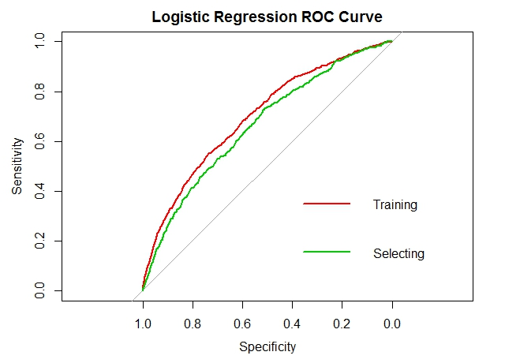
Model Selection
AUC:
Training set: 0.6990
Selecting set: 0.6736
Variables with significant p-value
count_over30
count_donate_camp
longtime_donor
count_activation
gender_M
gender_S
gender_U
zipcode_2digit_93
zipcode_2digit_SW
min_donate_over30_no
max_donate_over30_no

Slide 10
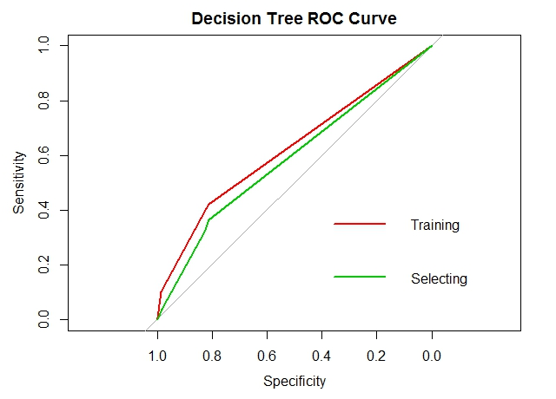
Model Selection
AUC:
Training set: 0.6144
Selecting set: 0.5927
Variables with high importance
zipcode_2digit
avg_donate
avg_donate_over30
avg_camp_donate
avg_camp_donate_over30
min_donate
min_donate_over30
avg_gap_donation
…

Slide 11
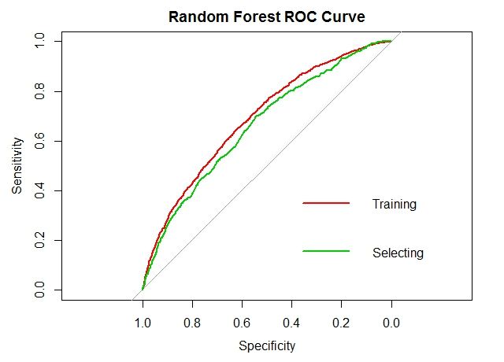
Model Selection
AUC (ntree=100):
Training set: 0.6804
Selecting set: 0.6781

Slide 12
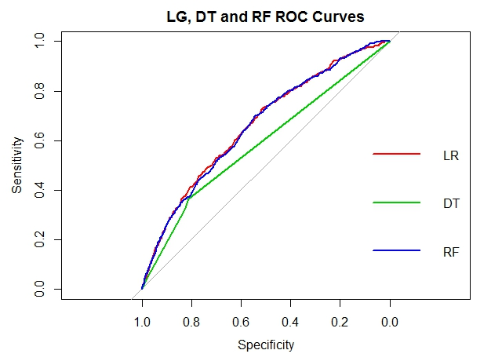
Model Selection
AUC comparison
Model | Training | Selecting
LG | 0.6990 | 0.6736
DT | 0.6144 | 0.5927
RF | 0.6804 | 0.6781
Notes:
train select LG 0.6990345 0.6735664 DT 0.6144097 0.5926709 RF 0.6803936 0.6780972

Slide 13
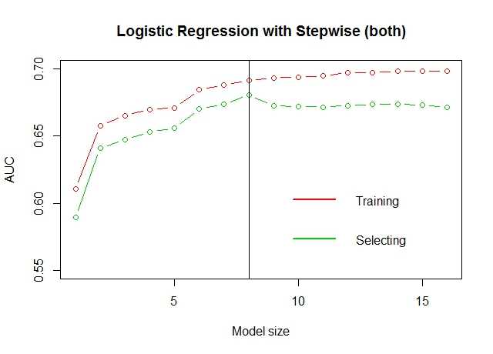
Logistic Regression with Stepwise (Both)
Final model
Size: 8 variables
AUC training: 0.6912
AUC selecting: 0.6804

Slide 14
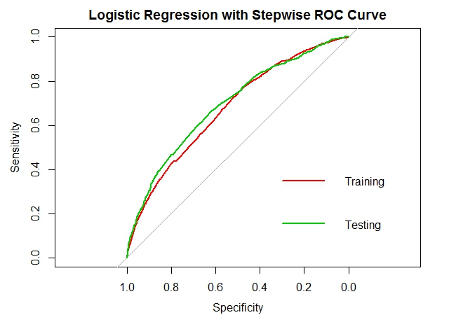
Final Model: Logistic Regression
Final model
Size: 8 variables
AUC training: 0.6912
AUC testing: 0.6564

Slide 15
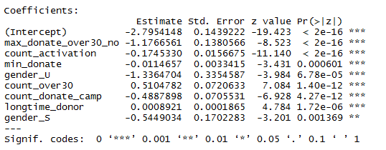
Final Model: Logistic Regression

Slide 16

Business Interpretation
Lift, Cumulative Gains
Profiling, Recommendation

Slide 17
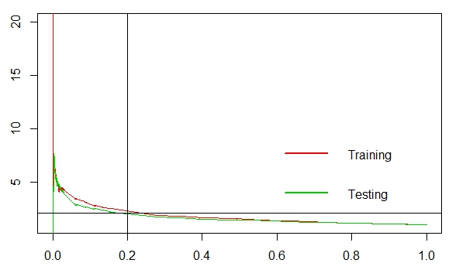
Lift Curve
Best 20% of observations have a lift of 2
Notes:
attractiveness of the target group

Slide 18
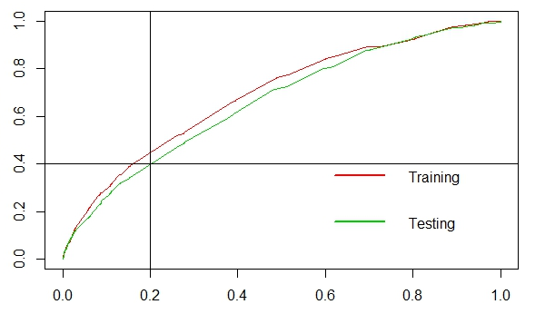
Cumulative Gains
Best 20% of observations contain 40% of responses
Notes:
efficiency of the target group

Slide 19
Current Response Rates
Cam. No. | Sent | Gift ≥ 30 | Responding Rate
5233 | 31320 | 646 | 2.1%
6169 | 34888 | 495 | 1.4%
7006 | 28751 | 351 | 1.2%
7075 | 31910 | 341 | 1.1%
7213 | 25618 | 279 | 1.1%
7244 | 25645 | 142 | 0.6%
7345 | 30927 | 224 | 0.7%
Total | 209059 | 2478 | 1.2%
Future Campaign (CampID = 7541)
Average gift value of a donate over 30 EUR: 46.56 EUR
Total selected donors: 31960 donors
Average responding rates (over 30 EUR): 1.2%
Total response with a gift over 30 EUR: 384 donors
Letter sending cost: 0.98 EUR
Total sending cost: 31,376.68 EUR
Total earning: 17,856.12 EUR
P/L: (13,520.56) EUR

Slide 20
Response Rates (20% donors; Lift = 2)
Cam. No. | Sent | Gift ≥ 30 | Responding Rate
5233 | 31320 | 646 | 2.1%
6169 | 34888 | 495 | 1.4%
7006 | 28751 | 351 | 1.2%
7075 | 31910 | 341 | 1.1%
7213 | 25618 | 279 | 1.1%
7244 | 25645 | 142 | 0.6%
7345 | 30927 | 224 | 0.7%
Total | 209059 | 2478 | 1.2%
Future Campaign (CampID = 7541)
Average gift value of a donate over 30 EUR: 46.56 EUR
Total selected donors (20% best): 6392 donors
Average responding rates (over 30 EUR): 2.4%
Total response with a gift over 30 EUR: 135 donors
Letter sending cost: 0.98 EUR
Total sending cost: 6275.34 EUR
Total earning: 7142.45 EUR
P/L: 867.12 EUR

Slide 21
Descriptive Profile
Gender
Male, Female, Couple, Company

Slide 22
Descriptive Profile
Gender
Male, Female, Couple,
Company
Location
Antwerp, Flanders

Slide 23
Descriptive Profile
Gender
Male, Female, Couple,
Company
Location
Antwerp, Flanders
Namur, Luxembourg

Slide 24
Descriptive Profile
Gender
Male, Female, Couple,
Company
Location
Antwerp, Flanders
Language
Dutch Speakers

Slide 25
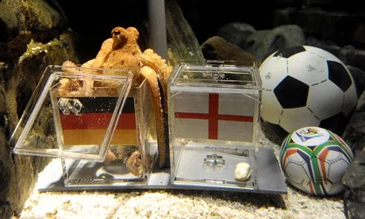
Predictive Profile

Slide 26
Predictive Profile

Slide 27

Predictive Profile
Gender
Company, Unknown (-ve)
Historical Behaviour
Times donated over 30
Association for long?
Maximum donation over 30?
(-ve)
Kept in many reactivation campaigns
Donate in more than one campaign?
Donated very less?

Slide 28

Thank you!

Slide 29
Appendix
Future improvements
Transform variables f(x) = (x / 30) ^ 3
Random Forest ntree=1000 and other models
Add more geographic information of Belgium (avg. age, income, household…) Link: http://freegisdata.rtwilson.com/
Summary factor variables in 1-incident (%)
Look for predictors that make a donor not donate (change POV)
Questions
Does multi-collinearity reduce AUC? When to drop those variables?
How to interpret Random Forest?
When shuffling the training/selecting dataset, AUC and variables change. How to deal with this issue in real life?

Slide 30
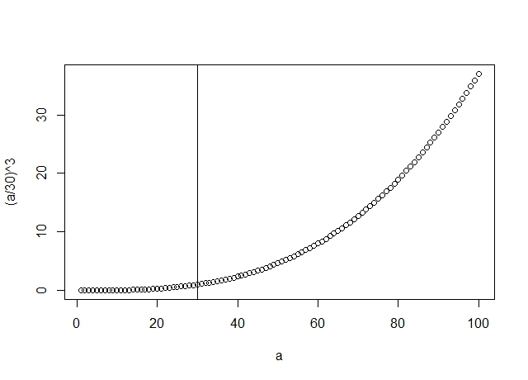
Appendix
F(x) = (x / 30) ^ 3

